Slide 1

Kepler and the Camera Obscura

Slide 2
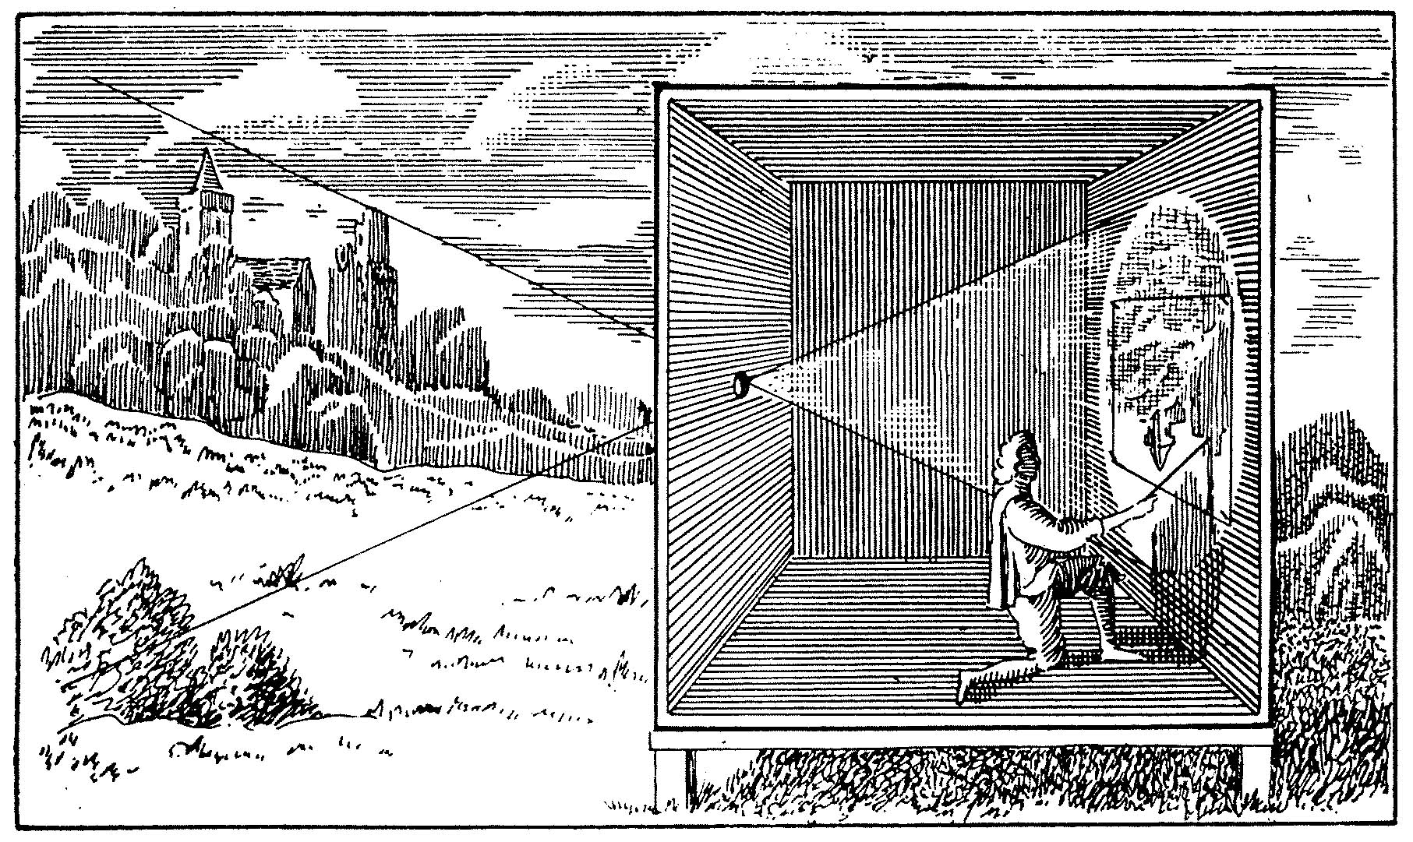
Camera Obscura (ca. 1650)

Slide 3
Analogies and Metaphors
Scientists began to explore mechanical devices as conceptual resources for explaining natural phenomena; i.e., they reasoned by analogy from processes that they thought they understood well to processes that needed explanation.
At the same time, these devices (esp. optical devices) moved to the center of their research interests.

Slide 4
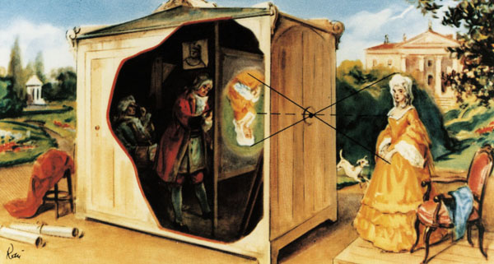
Camera Obscura (ca. 1750)

Slide 5

The camera obscura
Pinhole camera – known since antiquity. A pinhole camera, also known as camera obscura, or "dark chamber", is a simple optical imaging device in the shape of a closed box or chamber (or even a dark room). In one of its sides is a small hole which, via the rectilinear propagation of light, creates an image of the outside space on the opposite side of the box that is projected upside down.
The reason this happens is that light travels in a straight line, but when some of the rays reflected from a bright subject pass through a small hole, they become distorted and end up as an upside-down image. Imagine trying to squeeze an object into a space that is too small for it.

Slide 6
Da Vinci noticed that this is exactly the way the human eye sees things: light reflects off the surface of the object you are looking at and travels through a small opening on the surface of the eye (your pupil), and the image ends up flipped upside down.
He wrote, “No image, even of the smallest object, enters the eye without being turned upside down.” But he couldn't seem to figure out how a human eye actually sees the image right-side up. He didn't know what we know, that the eye’s optic nerve transmits the image to the brain, which then flips it right-side up. So the only thing the camera obscura lacks is a brain to flip the image!

Slide 7
Brahe’s puzzle
The great observational astronomer Tycho Brahe found in 1600 that the lunar diameter as formed by the rays in a camera obscura appeared smaller during a solar eclipse than at other times. Brahe’s observation generated a curious intellectual puzzle that seemed to admit only two solutions: either the Moon itself changed sizes or moved further away from the Earth during the solar eclipse; or Brahe was somehow being deceived by the camera obscura.
Kepler’s solution: The puzzle involves the optics of the visual images (which he called "pictures") formed behind the small apertures in the pinhole camera. The changing diameter of the moon was caused by the inter­section of the optical mechanism with the rays of light. The deception detected by Brahe, Kepler reasoned, is built into the pinhole camera.

Slide 8
Anti-Anthropocentricism
With Kepler’s pioneering work in vision science, the anti-anthropocentrism implicit in Copernicus’ treatment of the Earth as just another celestial body was now bolstered by science. As Kepler's views gathered momentum during the course of the seventeenth century, it is easy to see why natural philosophers (e.g., Robert Hooke and his celebrated illustration of the eye of a grey drone fly) became consumed with studying the eyes of other animals and in recon­structing the world as pictured by their optical mechan­isms.

Slide 9

Kepler’s Philosophical Legacy
Kepler’s work with the camera obscura stimulated the direction of philosophy in two ways:
(a) the connection that he drew between seeing and picturing coalesced into a metaphor that described the relation of a perceiver and the position of a knowing subject to an external world; and
(b) the analogy that he drew between the camera obscura and the human eye proved to be instrumental to the creation of the mechanical philosophy.

Slide 10
Visualization as Picture-Making
Kepler’s claim that vision is a kind of picture-making raised a new set of epistemological and psychological problems, concerning the relationship between observer and external world, that resulted in the creation of a philosophical metaphor that profoundly influenced the direction of content of philosophical theory during the seven­teenth century and beyond.

Slide 11
Descartes and Kepler
Descartes then turned to the associated epistemo­logical issues raised by Kepler’s metaphor, taking the view that picturing does not work by denotation, and so the pictures painted on the retina do not require the existence of external objects that resemble these pictures. These issues in the theory of representation have been revisited by contemporary philosophers and are well documented, but few scholars are aware that these issues exploded on the philo­sophical landscape as a consequence of Kepler’s work with the camera obscura.

Slide 12
Kepler’s Influence on British Empiricism
“external and internal sensations … are the windows by which light is let into this dark room … would the pictures coming into such a dark room but stay there and lie so orderly as to be found upon occasion it would very much resemble the understanding of man” (2, 11, 17). The camera obscura, in this passage from John Locke’s Essay Concerning Human Understanding, is used to restructure the process of observation: the operation of the mind is completely separate from the apparatus that allows the formation of “pictures” or “resem­blances.” Locke professes that the manner by which impressions made on the retina by rays of light produce ideas in our minds is “incomprehensible,” but this model was conducive to a juridical role to the observer within the camera obscura that allows the subject to guarantee and to police the correspon­dence between the external world (objects that putatively causer sensations) and interior representations (ideas) and to set aside anything disorderly. The camera obscura, then, as a model of perception was used by Locke to provide an answer to the problem raised by Kepler’s claim that a picture is painted on the retina in vision — namely, scepticism with regard to the senses.

Slide 13
The Mechanization of Nature

Slide 14
The project of the Meditations
Application of systematic doubt.
Response to the revival of the scepticism of Sextus Empiricus
There is something that can be known by the mind independently of sensible experience: “je pense, je suis.” This is the authority of reason.
Also, we can arrive at a basic conception of matter in terms of the geometrical property of extension.
These are the elements of Descartes’ famous substance dualism.
Rationalist vs empiricist schools on the question of the source of knowledge.

Slide 15
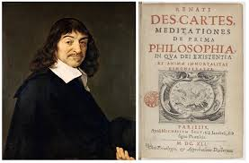
Meditationes de prima philosophia

Slide 16
The Mechanical Philosophy
The guiding assumption of Descartes’ mechanical philosophy: All natural phenom­ena, from the motions of celestial bodies to animal and vegetative life, can be explicated in terms of the geometrical property of extension and its proper modes (size, shape, position, and the disposition of its parts to be moved). Descartes' mechanical cosmology attempts to restate substantive results in optics, astronomy, and in mathematics in order to forge a foundation in physical theory for the Copernican hypo­thesis, which Descartes accepted on account of its simplicity and clarity.

Slide 17
The Relativity of Motion
The idea that motion is relative to a frame of reference is implicit in Copernicus’ anti-anthropocentrism; i.e., from the position of the stars that are situated at enormous distances from the planetary system, the Earth is hardly moving at all.
Galileo defends this principle in a number of places, but especially with a thought experiment about experiments conducted on a moving barge. https://www.youtube.com/watch?v=0YrDXU1Ll4k
Kepler defended this principle in his book, The Dream.
https://www.youtube.com/watch?v=0YrDXU1Ll4k

Slide 18
Descartes and the relativity of motion
If the Earth is carried about in its motion by a fluid medium, it is at rest relative to this medium but in motion relative to the Sun.
Descartes rejected the ordinary idea of motion as "the action by which some body travels from one place to another." If we observe that as much effort is required to put a moving body to rest, as is required to put a resting body in motion, we can see that the suggestion that motion requires an effort, whereas rest does not, is mistaken. It is therefore improper to treat motion and rest as different orders of being and to suppose that one needs more power in order to put in motion a body that is at rest than, conversely, to bring to rest a body that is in motion. "The truth of the matter", Descartes submits, is that motion "is the transference of one part of matter or of one body, from the vicinity of those bodies immediately contiguous to it and considered as at rest, into the vicinity of (some) others." Accordingly, motion is more appropriately conceived as a relational property; i.e., as the change of distance between bodies. Since it is always in contact with bodies that are immediately contiguous to it (i.e., the atmosphere), this definition enabled Descartes to assert that the Earth, properly speaking, does not move.

Slide 19
Descartes and the Causes of Motion
Motion has two causes, a universal and primary cause, and a particular cause that results in corpuscles of matter having some motion, which they previously lacked.
The universal cause is a law of conservation, which is justified by an appeal to God's nature, according to which God always acts in a consistent way, maintaining the same quantity of motion and rest that he put into the world when he first created it. From a consideration of God's immuta­bility, we can arrive at the knowledge of three laws or particular causes of the diverse movements of individual bodies.

Slide 20
Particular causes of motion
FIRST LAW: “each thing, as far as is in its power, always remains in the same state; and that consequently, when it is once moved, it always continues to move." In the absence of external distur­bances, all modes and attributes of matter are conserved from moment to moment in exactly the same state by God's creative concourse. If a particle is moving, it does not come to a stop of its own accord. By the same token, if a body is at rest, it does not simply start moving. This ontological equivalence of rest and motion is the very heart of the new concept of inertia fashioned by Descartes. Motion and rest are similarly positive states of bodies that are conserved in the absence of external actions.

Slide 21
Second law of motion
The first law does not specify in what direction(s), if any, the bodies move.
THE SECOND LAW” "all movement is, of itself, along straight lines ..." The critical insight here is that rectilinear motion is the only direction that can be uniquely and completely defined at a given moment of time. It is therefore the only direction that can be conserved by God in exactly the same way as in the previous moment. Descartes recognized that motion does not take place in an instant of time. However, he reckoned that God conserves a body just as it is in the moment that it is preserved. If, as Kepler had asserted in his New Astronomy that curved motions are the privileged paths described by bodies, this would require that God concern himself with two successive moments of time, an implication that conflicts with the first law of motion. Indeed, if a body were to describe a curved path, this would indicate that some external cause has affected its inertial state. With this law, Descartes dissolved the long-standing problem concern­ing the cause of motion, which sustained medieval impetus theories, and directed scientists to a problem that held the key to the formulation of a celestial dynamics, namely, what causes changes of motion.

Slide 22
Descartes vs Newton on inertia
The two laws both rely on the conserving activity of God. Together they hold that God conserves a quantity of action, determined in a unique direction, which is maintained from one moment to the next. Motion is therefore, on Descartes' account, a series of actions that occur at discrete moments of time. Moreover, this action at a moment of time is not the cause or reason of subsequent actions. Although Descartes is rightly credited with the law of inertia, the very foundation of the modern science of dynamics, motion in a straight line is not uncaused, as Newton will assert a half-century later, but is supported by the conserving activity of God.

Slide 23
Descartes and the mechanics of circular motion
When we whirl a stone in a sling, it tends to recede from the center of motion. Planetary motion is a result of the interaction of two actions: an inward pressure from densely packed material and a centripetal tendency to move outward from the center. The path described by the planets ia a balance between these two actions.

Slide 24
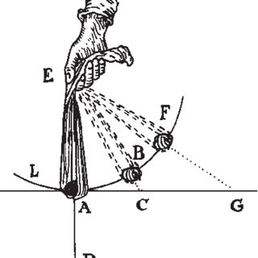
Motion in a Sling (Descartes)

Slide 25
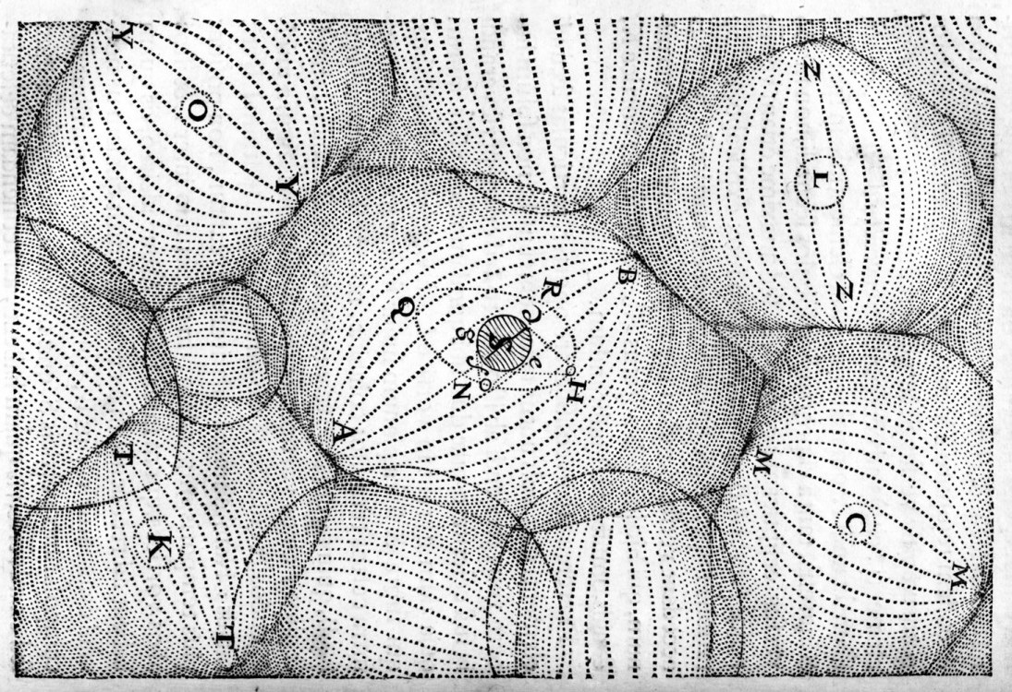
The Vortex Theory of Planetary Motion

Slide 26
Bacon and the Great Instauration
Global reform of the sciences. Call for a new beginning and a rejection of the teachings of the ancients, the schools, etc.
Incorporates a notion of progress that is new and would be one of the guiding principles of the Enlightenment.
Progress: change that is directed and desirable.
Evolution: change that is not directed.

Slide 27
Collaboration in the search for knowledge
The ideal of the new experimental practice that bloomed during the seventeenth century is that science is an imperfect body of knowledge that can be remedied and perfected by many hands, spanning many generations of practitioners. This ideal of the collaborative character of scientific practice was a cornerstone of the new seventeenth century experimental philosophy of nature. It is an ideal that seeks to balance theory and practice, the power of reason and experience, and two different cultures that shared a common goal and a project.

Slide 28
Bacon’s Legacy
Bacon championed the new generation of natural philo­sophers with the emphasis on observation and experiment, and a disdain for those who would defer to the authority of the ancient philosophers. Experiment would allow humanity to control nature.
Bacon showed no appreciation of the great scientists of his day — Gilbert, Copernicus, Galileo, Kepler, or even Harvey, his personal physician — but his inspiration led directly to the formation of The Royal Society.

Slide 29
Inductivism/experimentalism
Induction is a form of inference (particulars to generalizations). Bacon self-described as an inductivist (as did Newton), but for Bacon inductivism was a method of arriving at scientific knowledge through the use of experimental procedures that would be grounded in the phenomena of nature (i.e., general truths that are revealed to us through experiment).

Slide 30
Bacon, Newton, Robert Boyle, and alchemy
For the Aristotelian, an object is a union of form and matter. These forms are viewed as immutable and unchanging.
Alchemists were convinced that these forms can be transmuted, one into another. An inferior metal (e.g., lead) could be converted into a nobler metal (silver or gold) given the application of appropriate scientific procedures .
Alchemists were deeply suspicious of observation simply because a form could change from moment to moment.

Slide 31
The Royal Society
About fifteen years after the publication of Bacon’s Novum Organum, a group of individuals began to meet weekly to discuss problems in natural philosophy. In the disturbed times of the Restoration, the meetings were scattered and uncertain but were resumed at Gresham College, London. In 1662, Robert Hooke was appointed Curator to the Society. As Curator, his job was to provide “three or four considerable experiments” each day the Society met. Hooke knew most of the instrument makers of London, and his inventions and their skill helped to inspire and provide for the new interest in natural philosophy. Instruments and machines were designed, constructed and purchased. Hooke’s work with the microscope and Newton’s work on optics and astronomy stimulated the optical instrument trade.

Slide 32
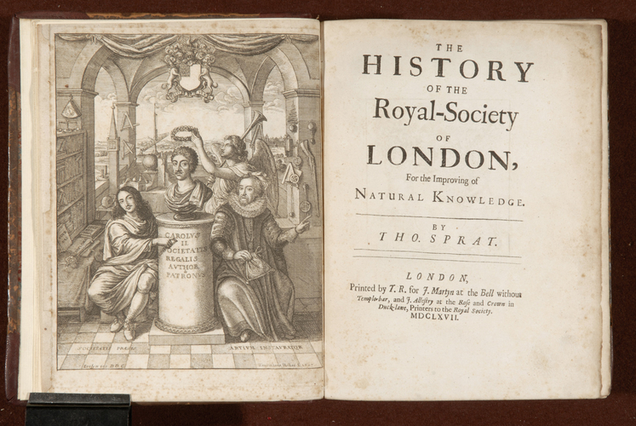
Frontispiece of Spratt’s History of the Royal Society

Slide 33


New Theatres of Nature

Slide 34
The discovery of smallness
One interesting expression of the bias due to the reliance on common sense is the belief (which was universal during the Middle Ages and Renaissance) that small organisms (e.g., fleas, lice)that are on the very threshold of sensation are structurally insignificant.
Ordinary observation reveals that many organisms (e.g., horse, cat) are complicated with many moving parts, and so this bias supported the belief that smallness is synonymous with simplicity.
Prior to the invention of the microscope, the world was not much interested in tiny organisms at the very threshold of sensation; these organisms were pests but nothing more. Small things were petty and insignificant.

Slide 35

The Doctrine of Spontaneous Generation
The scientific expression for this idea (which was the by-product of the authority conferred on ordinary sensation) that smallness is insignificant is the doctrine of spontaneous generation, which held that smallness is not an obstacle to generation.
Indeed, if one was to “Collect a number of fly cadavers and crush them slightly. Put them on a brass plate and sprinkle the macerate with honey-water… you will see… otherwise invisible worms, which then become winged, perceptible little flies, and increase in size to animated full-fledged specimens.” So said Athanasius Kircher in 1668, a Jesuit natural philosopher, echoing the wide spread belief at the time that flies (among many other small organisms, did not breed but arose out of inert material.

Slide 36

The doctrine of spontaneous generation can be traced to Aristotle, and during the Renaissance it was widely believed that ants formed out of sour wine, worms from soil, and household pests like lice, fleas and bedbugs from human sweat.
The work of the microscopists (Leeuwenhoek, Hooke) challenged this doctrine but did not overthrow it.

Slide 37
Complicated vs complex
A complicated system is one that is built in a mechanical fashion out of simple systems. If we understand the laws that govern a simple system, we can reduce the laws that govern the complicated system to a simple system.
A complex system cannot be reduced to a simple system: complex systems feature properties that emerge at different levels of organization.

Slide 38
The marginalization of Robert Hooke
Almost unrivalled number of inventions, including the air pump that is usually credited to Robert Boyle.
Expertise across a range of scientific fields.
Exceptional artist and architect.
Gave Newton the suggestion that the best explanation for an elliptical orbit would be an inverse square force. Also, gave Newton the suggesrion that the planet’s motion should be understood in terms of a centripetal (attractive) force.
Nevertheless, he is remembered as ingenious, in part because he did not make major contributions to mathematical subjects. Ingenious is a reference to labour with one hands, which epistemically was regarded as an inferior way of knowing.

Slide 39
The Gray Drone fly
The fly has more than 1900 hundred different segments (Hooke counted them). The fly can see in 360 degrees; here the laws of linear perspective do not hold. His optical apparatus is far superior to our own. His apparatus is “sophisticated.”

Slide 40
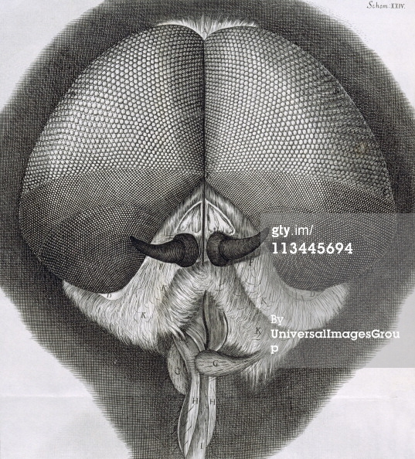
Hooke, Gray Drone Fly (Micrographia)

Slide 41
The Flea
Hooke does not tell his reader what kind of flea he is picturing. He was not interested in comparative anatomy and there is no evidence that he was aware that there are kinds of fleas (i.e., species adapted to humans, cats, dogs, rats, etc.).
Also, compare Hooke’s picture with a photo of a flea using a modern compound microscope. The flea is ordinarily transparent, whereas Hooke’s flea looks armored. The reason is that he dipped his insect specimens in brandy to stop them from moving which, in turn, stained them and gave the appearance of a hard body.

Slide 42
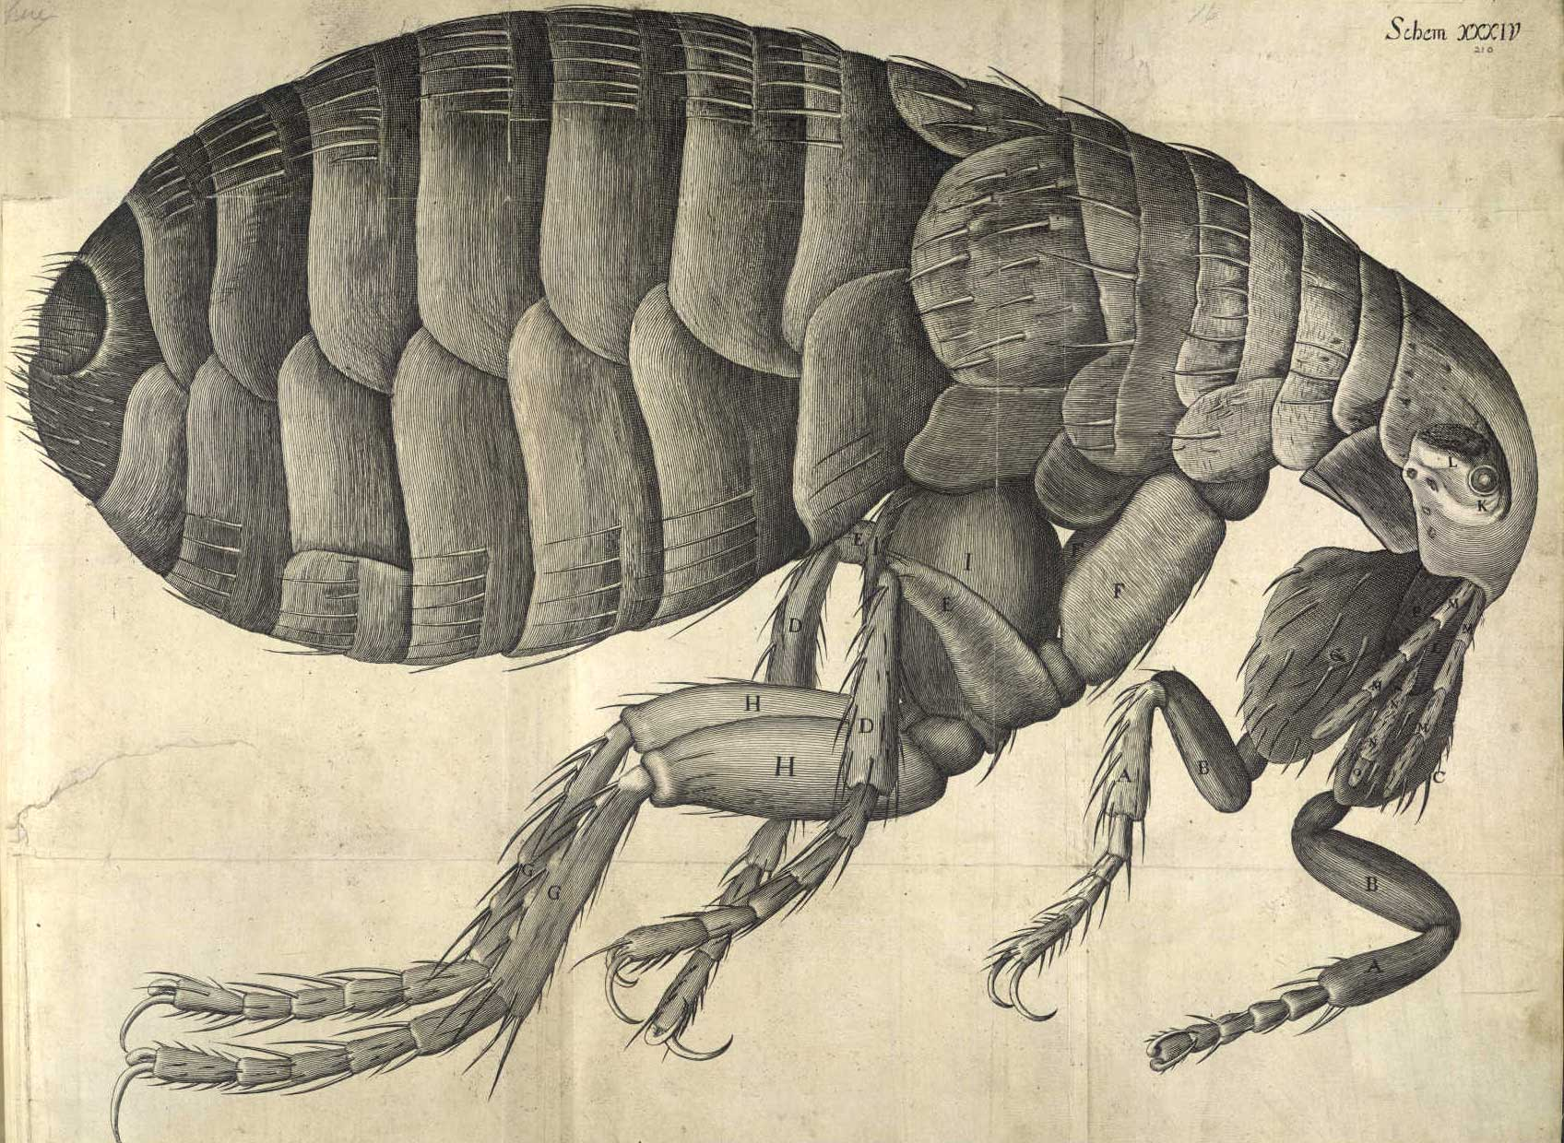
Hooke, Flea (Micrographia)

Slide 43

Rat flea, infected with Yersinia pestis

Slide 44
The flea (continued)
Now look at the photo of a rat flea that is infected with the bacterium that causes plague. Note that London endured the Great Plague during the years 1664-65, which killed a quarter of its population (estimated at 600,000 people).
Hooke’s flea appears to be a rat flea (though Hooke is insensitive to this and does not say where he obtained his sample).
He would not have been able to visualize the infection in the flea’s gut due to his method of processing his specimen.
He would not have been sensitive to the thought that an individual organism can be the host to other organisms.

Slide 45
Structure
As useful as Hooke’s microscope was as a tool of observation, the fact is that much of what he reported could have been seen with the unaided eye. Hooke’s microscope revealed this complexity in all its detail but the complexity itself was there to be seen. So why did it escape everyone’s attention?

Slide 46
Leeuwenhoek’s simple microscope
Leeuwenhoek was a draper who was accustomed to examining cloth for signs of “sophistication.”
He started making his own simple microscopes.
His microscopes have a magnifying power of some 270 times.

Slide 47
Leeuwenhoek and the Mechanical Philosophy
The guiding principle of the mechanical philosophy: life and mobility are identical.
With his microscope, Leeuwenhoek concluded that the moving objects he saw through his micro­scope were little animals.
He communicated his observations to the Royal Society in 1676, where they caused a sensation. In subsequent letters, he described many specific forms of microorganisms, including bacteria, protozoa, as well as his accidental discovery of ciliate reproduction. These organisms were hitherto invisible (new theatre of nature).
He also devised a scale to measure this formerly invisible world; his system of micrometry utilized as standards a grain of course sand, a hair from his beard, and bacteria in pepper water.

Slide 48
Sexual reproduction
Leeuwenhoek observed spermatozoa.
One explanation for these animalcules is that they were the product of putrefaction.
Leeuwenhoek insisted that they were a naturally occurring phenomenon, and set out to show that spermatozoa were universally found in nature. Dissected thousands of organisms in order to make this point.

Slide 49
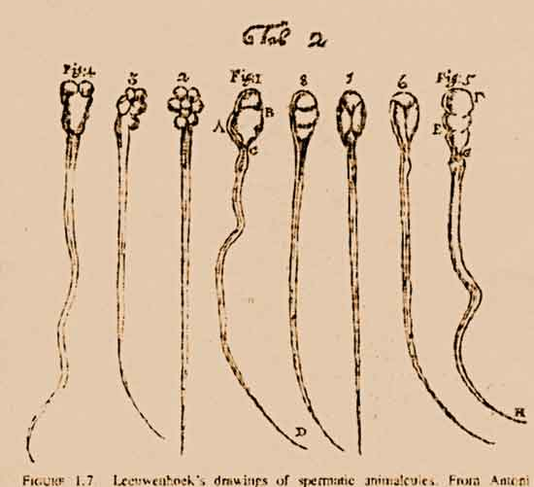
Spermatozoa (Leeuwenhoek)

Slide 50
Animalculism
Leeuwenhoek advanced a new theory of the fertilization process. Having observed spermatozoa, he was able to proceed beyond the prevailing belief that fertilization occurred from vapours arising out of the seminal fluid. He postulated that the spermatozoa actually penetrate the egg, even though he was unable to observe this process.
Assuming that the fast moving spermatozoa were the origin of all new animal life (since he equated life with mobility), he went on to state that the egg and the uterus nourished the new life. He thus denied any generative role to the motionless (and therefore lifeless) egg, and placed himself in direct opposition to those like William Harvey who held the egg to be the source of all new life. Leeuwenhoek thus arrived at an animalculist theory of reproduction.

Slide 51
A critical case was the reproduction of mammals. Following Harvey, the self-described “ovists” thought that the ovary follicle (membrane covering the sac which contains the egg) was in fact the egg, while Leeuwenhoek pointed out that it was impossible for the entire follicle to pass through the narrow fallopian tube to the uterus.
The actual mammalian egg was not found until 1832, and the ovist-animalculist controversy persisted until 1875 or so when it was demonstrated that fertilization represents the fusion of the nuclei of the spermatozoa and the egg.

Slide 52
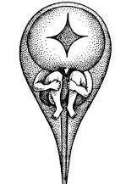
Homunculus (Preformation Theory)

Slide 53
Transmission of forms
The reigning metaphor for what we now think of as the communication of information.

Slide 54
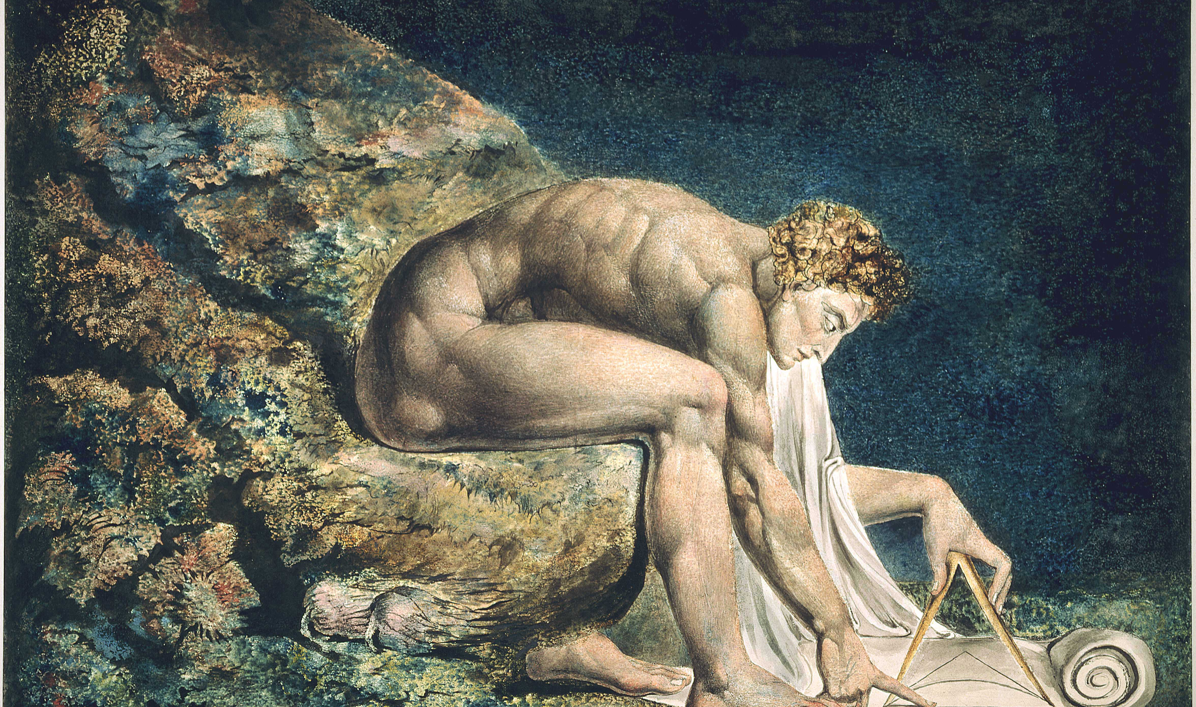
Isaac Newton, by William Blake

Slide 55
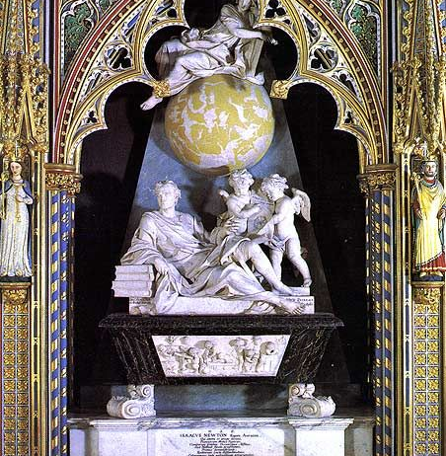
Newton’s Monument at Westminster

Slide 56
I’m opening this final section of HPS210S with a photo taken at Westminster Abby, the burial place for British royalty, statesmen, poets. Chaucer is buried here, in a corner surrounded by other poets.
Note that Newton’s tomb is up front, alongside the tomb of one other person – Horatio Nelson – who led the British to victory of the Battle of Trafalgar. A scientist and a sailor are honored here ahead of monarchs and statesmen.
Isaac Newton died in 1727. During his lifetime and for a short period thereafter, his scientific ideas were not part of the scientific consensus. It was not until 1740 or so that text books based on his ideas started to be taught at leading universities in Europe and in North America. BY 1750 or so, his ideas had come to be seen as a framework or a template for all of intellectual endeavors, and many social and political reforms, not just science.

Slide 57
Newton’s Legacy
Newton contributed to many different fields of inquiry.
He was a practicing alchemist for most of his life and used his knowledge of metals to great effect when he was made Master of the Mint of England. During his tenure, many forgers met their death due to the analyses and judgement provided by Newton.
Newton was also an expert on the Old Testament. In his The Chronology of Ancient Kingdoms Amended (1728), he attempted to reconcile Jewish and pagan dates, and to fix them absolutely from an astronomical argument about the earliest constellation figures devised by the Greeks. In Observations upon the Prophecies of Daniel and the Apocalypse of St John (1733), Newton also wrote on Judeo-Christian prophecy, sustained by the conviction that its decipherment was essential to the understanding of God.

Slide 58
Newton’s Work in Mathematics
In terms of his straightforward scientific interests, there are three central areas that drew Newton’s attention.
The first is mathematics. Newton laid the foundations for the differential and integral calculus. He produced simple analytical methods that unified many different techniques that had been developed to solve problems that were thought to be unrelated. In particular, he was renowned for his solutions to the problems in analytical geometry of drawing tangents to curves (differentiation) and defining areas bounded by curves (integration). Newton discovered that these problems were inverse to each other, and designed general methods of resolving problems of curvature — his “method of fluxions” (from the Latin meaning "flow") and “inverse method of fluxions.” Fluxions were expressed algebraically, but Newton made extensive use of analogous geometrical arguments.

Slide 59
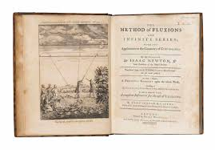
The Method of Fluxions (1736)

Slide 60
Work in Optics
Newton constructed the first telescope that used a curved mirror to prevent light from being broken up into unwanted colors. He was elected a Fellow of the Royal Society in 1665 for this telescope.
He also contributed to optics by showing that homogenous white light is made up of the colors of the rainbow. In a remarkable experiment, Newton passed one of the beams of colored light through a second prism and showed that it was not colored by the spectrum and so must be a constituent of white light.
Reactions to Newton’s experiment were negative. The inability of the French physicist Edmé Mariotte to replicate Newton’s prism experiments in 1681 entrenched the rejection of Newton’s optical theory for a generation. Newton delayed the publication of his Opticks (published in 1704; revised in 1706), which was largely composed in 1692, until his critics were dead. The manuscript of his original lectures was printed in 1729 under the title Lectiones Opticae.

Slide 61
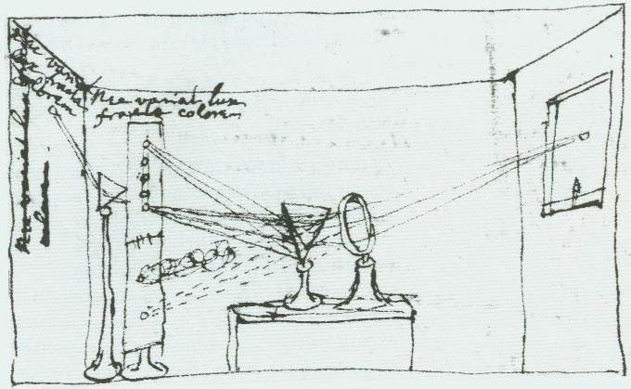
Newton’s drawing of his experimentum crusis

Slide 62
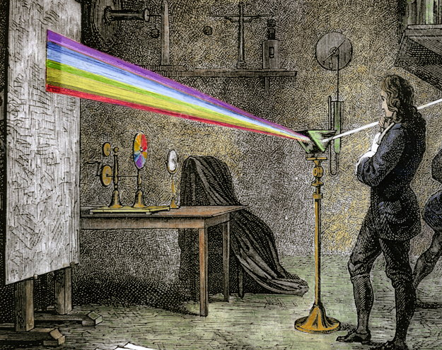
Colored drawing of Newton’s experiment

Slide 63
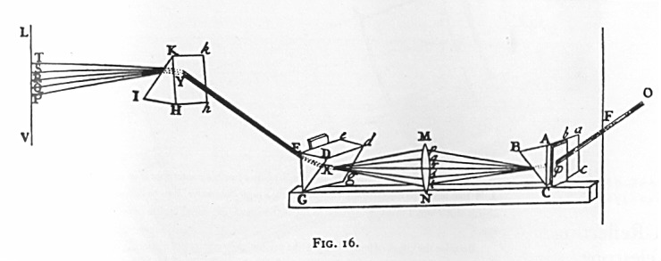
Reconstruction of Newton’s Experiment

Slide 64
Newton’s Great Idea
Newton’s great idea was the law of universal gravitation.
In the 17th century, people were well aware of the particularities of their situation. There were many languages, many sets of customs, many systems of justice. Life hummed in many distinct patterns.
Newton gave the world a universal expression that applied to all bodies whatsoever. He expressed this relationship in a precise and quantitative form. In doing so, he unified entire branches of science that were long thought to be distinct (celestial and terrestrial mechanics) and gave a blueprint to others in their attempts to find unity is a world filled with disunity.

Slide 65
Newton’s Style of Reasoning
Indeed, Newton’s treatment of such phenomena as the eccentric orbits of comets, the tides and their variations, the precession of the Earth's axis, and the motion of the Moon as perturbed by the Sun's gravity arguably created the science of physics and the form or characteristic style of explanation that we find in Newton's seminal treatise— The Principia (1687) -- still holds sway in physics today.

Slide 66
Newton’s Annus Mirabilis (1666)
Anyone of these contributions would have secured Newton a prominent place in the pantheon of science. Taken together, it is clear why his achievements cast such an immense shadow across the physical sciences.
What is remarkable is that the central insights that shaped his contributions to all three areas emerged during the period (1666) when Newton was hiding out in the country due to the devastating outlook of the plague in London.

Slide 67
The End of Science
So dominant were Newton’s ideas that most scientists came to believe that these ideas would never be repealed – we may add to Newton’s work by studying forces other than the gravitational force – but the fundamental system of the world as modeled by Newton was thought to be fundamentally correct and irrevocable. There never could be another scientific revolution. So, of course, it came as a great shock when the 20th century witnessed 3 or 4 changes in fundamental ideas in the physical sciences.

Slide 68
Newton’s Rules of Reasoning
Newton included at the beginning of Book 3 in the second (1713) and third (1726) editions of his Principia a section entitled "Rules of Reasoning in Philosophy." In the four rules, as they came finally to stand in the 1726 edition, Newton effectively offers a methodology for handling unknown phenomena in nature and reaching towards explanations for them

Slide 69
Rule 1
Rule 1 We are to admit no more causes of natural things than such as are both true and sufficient to explain their appearances.
This rule is generally called the principle of parsimony. It is based on the conviction that nature is simple and explanations for its phenomena must be simple as well or at least the simplest explanation must be the most likely.

Slide 70
Rule 2
Rule 2 Therefore to the same natural effects we must, as far as possible, assign the same causes.
The second rule essentially means that special interpretations of data should not be used if a reasonable explanation already exists.

Slide 71
Rule 3
Rule 3. The qualities of bodies, which admit neither intensification nor remission of degrees, and which are found to belong to all bodies within the reach of our experiments, are to be esteemed the universal qualities of all bodies whatsoever.
We find that all bodies have inertia, mass, extension. Newton strongly resists the suggestion that gravitational attraction is a primary property of matter.
Another implication of this rule is that the laws of nature are invariant. Bodies will be governed by the same set of laws in North America and in the far reaches of space as they are here on Earth.

Slide 72
Rule 4
Rule 4. In experimental philosophy, we are to look upon propositions inferred by general induction from phenomena as accurately or very nearly true, not withstanding any contrary hypothesis that may be imagined, till such time as other phenomena occur, by which they may either be made more accurate, or liable to exceptions.

Slide 73
Newton’s Achievement
Overall, what Newton managed to do was to provide a remarkable new solution to a very old problem – what is the center of the planetary system, the Earth or the Sun? Some had sided with the ancient view of a geocentric universe because it accorded so well with common sense. We do not have a sensation of a moving Earth, etc. Others took up the new idea for any number of reasons but one was that it presented an interesting challenge to scientists to fashion a physics of a moving Earth.
From the date of the publication of On the Revolutions of the Heavenly Spheres in 1543 by Copernicus, no one had arrived at anything life a physics for a moving Earth.

Slide 74
From Kepler to Newton
One mathematician, as we have seen, who was very taken with Copernicus’ hypothesis was Johannes Kepler. He inherited some data on the observed positions of Mars at very particular times in its orbit, and found that the planets did not do what Copernicus had suggested. Rather they moved around the Sun in squashed circles or in elliptical orbits. This is not quite true but happens to be approximately true for Mars, which has a very eccentric orbit.

Slide 75
Kepler also found that there was a very particular relationship between the time that the planets took to do around the Sun (the planet) year and their distances from the Sun. The square of the planet’s orbital period is proportional to the cubes of their mean orbital radius. This relationship (formalized in Kepler’s third law of planetary motion) was a constant for all planets, irrespective of their distances and their masses. Clearly, the Sun played a very prominent role in this dance of the planets but Kepler was unable to explain why the planets moved as they did.

Slide 76
Newton and the Story of the Apple
The story goes that Newton saw an apple fall to the ground and it made him wonder why the fruit always fell straight to the ground; why did it not veer off to the left or right? Newton’s own intuition, encapsulated in his law of inertia, was the anything that begins moving from a standing start is experiencing the action of a force. The apple started in the tree and landed on the Earth, which means there must be a force of attraction between the apple and the Earth.
And even if the apple were higher up in the tree, it would still feel this force of attraction with the Earth, reasoned Newton. In fact, the attraction shouldn't even stop at the top of a tree but carry on way up into the heavens. Which raised the question: if everything around the Earth should feel this force of attraction, including the Moon, why doesn't the Moon, our nearest neighbor, fall and crash onto the surface of our planet in the same way as the apple did?

Slide 77
Newton’s Orbital Cannon
Newton accepted the obvious consequence of his line of thought: the Moon was indeed falling towards Earth, just as the apple felt the gravitational force, but there was a very good reason why it didn't crash down.
He used a thought experiment why: imagine you fired a cannonball horizontally from the top of a mountain on Earth. The ball would follow a curved trajectory as it moved forward and was attracted, by gravity, towards the ground at the same time. Fire the cannonball with more energy and it would land further away from the mountain, but it still would follow a curved trajectory in doing so.

Slide 78
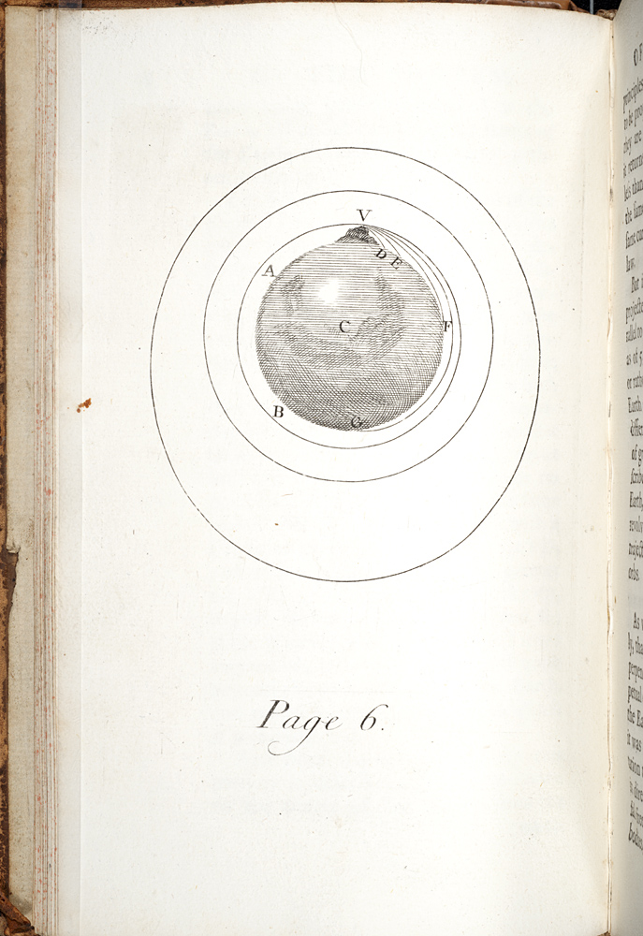
Newton’s orbital cannon (Principia, 1687)

Slide 79
The Moon as a Satellite
If even more energy were added to the firing of the cannon, eventually the ball’s own force and the gravitational pull of the Earth would balance each other: the cannon would move fast enough so that the gravity of the Earth never quite catches it. This is a very difficult concept for students, but it is the heart of Newton’s great discovery of 1666.
There is a great deal of controversy amongst historians whether any of this is true. Newton passed along the story of the apple in his dotage but what we do know is that in 1684, Newton produced a mathematical proof, which became the basis for the monumental Principia that he published three years later in 1687. The question he asked was: How far would the Moon fall if it stopped in its tracks? Newton calculated that in one minute the Moon, if stopped, would fall the same distance as would an object on Earth in one second: a convenient 60:1 ratio, a result of the lunar distance between sixty Earth-radii. This (so-called) Moon test was perhaps the most original of Newton’s arguments

Slide 80

The Problem of the Planets
18 years later, Newton would provide a mathematical proof for his youthful conjecture about the universality of gravitational attraction and he would go on to relate his Kepler’s laws of planetary motion, showing that for the most part Kepler’s laws are incorrect. His novel solution to the long-standing worries about whether the sun or the earth is at the center of the planetary system was that neither is at the center. The center, in fact, is the central of gravity for the system as a whole, which, as it happens, nearly coincides with the Sun simple because most of the mass of the solar system is part of the Sun

Slide 81
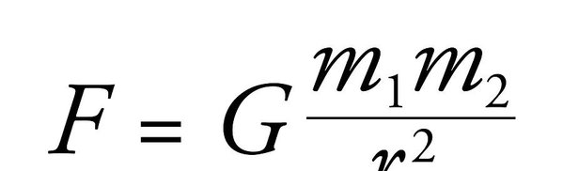
Newton’s Law of Universal Gravitation

Slide 82
The Inverse Square Relationship
Newton's law tells us that the strength of the gravitational force between two objects drops off in the same way that a light gets dimmer as you move away from it, a relationship known mathematically as an inverse square law.
Another way to visualize the drop-off in the field is to imagine the gravitational field around an object as a series of concentric spheres. Each sphere represents the same "amount" of gravitational field but the spheres further from the object are bigger, so that same amount of field is spread thinner, over a larger area. The field thus gets weaker as you move away from the object, in proportion to the surface areas of these spheres.
The m1 and m2 could be planets and stars or they could be you and the Earth. Compute the equation using numbers for your mass and that of the Earth, and you will get your weight, measured in Newton’s. Weight, in true scientific terms, is the gravitational force acting on your mass (which is measured in kilograms) at any point in time. Your mass will stay the same wherever you go in the universe but your weight will fluctuate depending on the mass and position of the objects around you.
Newton's law of gravitation is a simple equation, but devastatingly effective: plug in the numbers and you can predict the positions of all the planets, moons and comets you might ever want to watch, anywhere in the solar system and beyond.

Slide 83
Applications
And it allowed us to add to those celestial bodies too, heralding the space age. Newton's formula helped engineers work out how much energy we needed to break the gravitational bonds of Earth. The path of every astronaut and the orbit of every satellite from which we benefit – whether for communications, Earth observation, scientific research around Earth or other planets, global positioning information – was calculated using this simple formula.

Slide 84
Background to Newton’s Principia
Newton’s monumental Principia mathematica was published in 1687. A second edition appeared in 1713, and a third edition in 1726.
This book provided the foundation for classical mechanics and our modern picture of the cosmos.

Slide 85
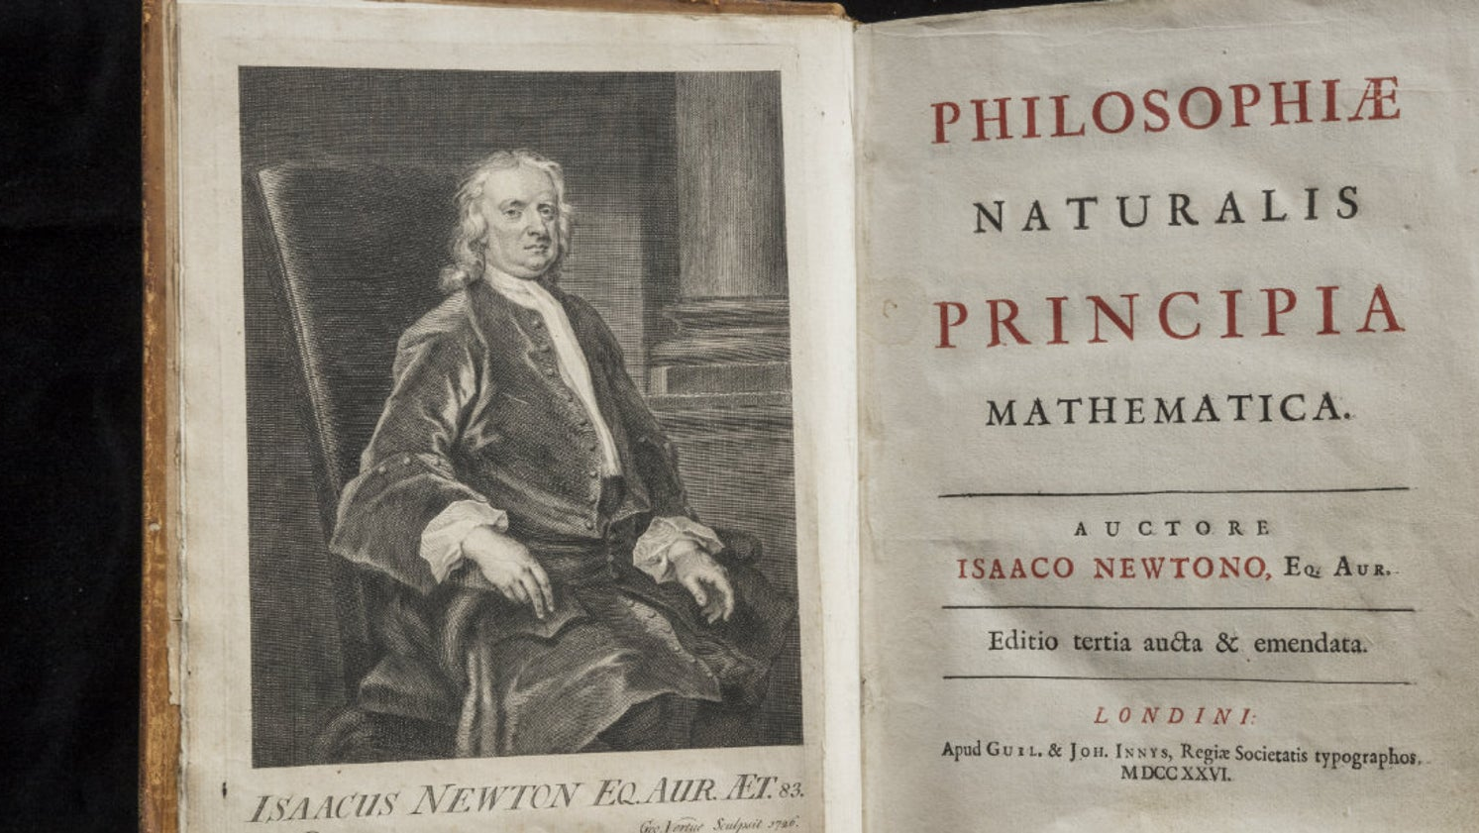

Slide 86
Hooke’s Problem
In 1679, Hooke had a brief discussion Newton, asking him what would be the path of a body given that the Earth ‘s “attraction” varied inversely as the square of this distance. Hooke pointed out publicly that the path would be an ellipse with a focus at the centre of the Earth. (In fact, the focus would be the center of attraction).
It was Hooke (though he has received little recognition for providing this insight) who first related Kepler’s elliptical orbits to the motion of a projectile under the Earth’s gravitation.

Slide 87
Halley’s Problem
By the early 1680’s, a number of mathematicians had deduced from Kepler’s third law that the Sun’s gravitation must vary inversely as the square of the distance.
Halley turned to the more intricate problem of finding the path of a body moving under such an attraction and failed.
Halley visited Newton in 1684 and asked presented a problem (Halley’s problem) to Newton: what the path of a moving body would be under the influence of gravity varying in the inverse square.
Newton claimed that he had made this calculation in 1679 but now in 1684 could not find it. He quickly wrote up a short manuscript and sent it to the Royal Society. He said that he would look more closely at the issues and write up a fuller account. He spent the next two years writing this fuller treatment.

Slide 88

Newton’s problem
Halley simply assumed that the gravitational force acted as the inverse square and asked Newton to deduce (predict) the planetary motions from this assumption. Newton regarded this as a simple mathematical puzzle that anyone could solve.
Newton focused his intellect on a different and much more difficult problem; namely, providing a scientific foundation for the contention that the force of gravity acts inversely as the square of the distance.
Newton says that he will “deduce” (but really means “induce”) this contention from “the phenomena of motions”).

Slide 89
Newton’s Style of Reasoning
“The whole burden of philosophy seems to consist in this — from the phenomena of motions to investigate the forces of nature, and then from these forces to demonstrate the other phenomena; and to this end the general propositions in the first and second Books are directed. In the third Book, I give an example of this in the explication of the System of the World; for by the propositions mathematically demonstrated in the former Books, in the third I derive from the celestial phenomena the forces of gravity with which bodies tend to the Sun and the several planets. Then from these forces, by other propositions, which are also mathematical, I deduce the motions of the planets, the comets, the Moon, and the sea.”

Slide 90
This second problem can be broken down into two further problems.
First, there is the analysis of the data concerning the orbits of the planets round the Sun, to the approximation that these orbits are circular with the Sun at the center. This is a difficult problem in view of the fact that the observational basis itself is suspect in Newton’s mind. The observations are produced by a complex number of factors, so Newton’s task is to discover just why the motions approxi­mate circular orbits. There is hint here given by the implication of the inverse square proportion, namely, that the planets should describe ellipses with the Sun in one focus. They do not and so the trick is to find out just why.
The second problem is to show the universality of gravitation. Newton’s analysis of the motion of the Moon holds the key to his solution to this problem.

Slide 91
Elements of Newton’s Argument
1. Definitions of space, time, and motion.
2. General principles of motion and force, including Newton’s three laws of motion.
3. Rules of Reasoning.

Slide 92
1. Definitions of Space, Time, and Motion
These concepts ultimately depend on Newton’s idea of God, of whom it is impious to think that he did not know where he was or what time it might be. Even without bodies or universes as landmarks, there must be absolute space and time. As Newton says at the end of Book III, “He endures forever, and is everywhere present; and, by existing always and every­where, he constitutes duration and space.”

Slide 93
2. General Principles of Force and Motion
These principles are positioned as “Axioms” at the beginning of the Principia, and a formidable battery of theorems derived from them in the preceding Books, especially Book I. (Together with the definitions, these constitute the first coherent statement of the fundamental laws according to which the motions of bodies are produced.) Among these axioms are Newton’s famous laws of motion:
(1) Every body continues in its state or rest, or of uniform motion in a right line, unless it is compelled to change that state by forces impressed upon it;
(2) The change of motion is proportional to the motive force impressed; and is made in the direction of the right line in which that force is impressed; and
(3) To every action there is always opposed an equal reaction: or the mutual actions of two bodies upon each other are always equal, and directed to contrary parts.
Newton credits Galileo with the first two laws, but the second law is a definition of measurement of kinetic force that Galileo never attained and that makes Newton the founder of dynamics, a term that was coined by Leibniz to characterize his concept of force that corresponds roughly to the modern concept of kinetic energy.

Slide 94
Newton’s ontology of force
Scholars have interpreted the procedure advanced in this passage as encapsulating the very essence of the Newtonian revolu­tion in science. Though Newton’s ontology included material corpuscles in motion. It also included the notion of force. Armed with the principle of inertia, force was held to change (or tend to change) the motions of bodies — the measure of the changes of motion serving as the measure of the force. The chief object of science became the discovery of the various forces acting in the world.
Another important factor is that, in Newton’s hands, the notion of force became a quantity. His approach thus held out the prospect for a truly mathematical physics in which various natural effects would be shown to follow in a rigorously demon­strative and quantita­tively exact manner from mathematically expressed laws of force.

Slide 95
Concerns about Gravitational Attraction
This concept was dismissed by many critics as an occult quality, calling for bodies situated a distance apart to act on one another across empty space.
Newton replied to his critics that he had demonstrated from the phenomena that attraction is a property of some bodies and generalized this claim to include all bodies. In the General Scholium to the Principia, written some twenty-six years after the publication of its first edition, Newton put the matter this way: “To us it is enough that gravity does really exist, and act according to the laws which we have explained, and abundantly serves to account for all the motions of the celestial bodies, and our sea.”

Slide 96
The Cause of Gravitation?
Newton recognized that he was not in possession of the cause of gravitation, of whose existence he was convinced. He tried to give a mechanical explanation in terms of an ethereal substance pervading all bodies and filling the space between them. But he was never able to demonstrate its existence in the way he thought he had demonstrated the existence of gravitation itself. In the General Scholium, he asserted that experim­ental philosophy has no room for such “hypotheses.” He would not, like his opponents, invent hypotheses merely to fill an explanatory gap.

Slide 97
Motion of Bodies in Resisting Media
The second book of Newton's great work features a mathematical analysis of the motion of bodies in resisting media; in effect, this book is a sustained examination of the dynamical conditions of vortex motion. A number of arguments are generated against the possibility of vortices; in particular, Newton argues that the vortex theory cannot be reconciled with Kepler's laws of planetary motion. The problem stems from the incompatibility between the velocity relations in Kepler's second and third laws. Applied to a single vortex, Kepler's second law requires the speeds of its layers to vary inversely as the distances; whereas the third law of periodic times demands that the speeds vary inversely as the square of the distances. The consequence is that the visible center of a vortex — any planet will do nicely — would have two different speeds at the same time.

Slide 98
Leibniz and the Principia
After reading a 12 page review of the Principia in Acta Eruditorum in 1688, Leibniz immediately countered what he perceived to be a damaging blow to the vortex theory of planetary motions with his "Essay on the Causes of the Motions of the Heavenly Bodies," that appeared in the February 1689 issue of the Acta. Leibniz's "Essay" set a precedent for Cartesian science by investigating the soundness of Kepler's laws in a world of vortices; i.e., in a world where motion encounters resistance as a matter of course. Kepler is characterized by Leibniz as "that incomparable man" whom "the fates have watched over that he might be the first among mortals to publish the laws of the heavens, the truth of things, and the principles of the gods".

Slide 99
Kepler’s Laws as Anti-Cartesian Arguments
Newton was alert to the potential of Kepler's laws as anti-Cartesian devices. Book II of the Principia closes with these famous words:
"... the hypothesis of vortices is utterly irreconcilable with astronomical phenomena [Kepler's laws], and rather serves to perplex than explain the heavenly motions. How these motions are performed in free spaces without vortices, may be understood by the first Book; and I shall now more fully treat of it in the following book"..

Slide 100
A Remonstration of the Vortex Theory
By 1700 some of the more distinguished Cartesians were struggling under Newton's influence to reconcile the vortex hypothesis with Kepler's laws of planetary motion. The publication in 1713 of the second edition of the Principia marked the turning point: it proved to be so popular that a reprint appeared a year later in 1714 and a second in 1723. Within the next thirty years or so, the list of Cartesians working to answer Newton’s challenge included such names as Bernard Bullfinger, Joseph Privat de Molières, the Bernoullis (Johann and Daniel), Jean Baptiste Duclos, and Pierre Cassini. And even though some of their proposals managed to reproduce one or another feature of Kepler's laws, none of these modified Cartesian theories could duplicate Newton's achievement. By 1740, all but the most vociferous Cartesians had admitted defeat.

Slide 101
The Shape of the Earth
Isaac Newton first proposed that Earth was not perfectly round. Instead, he suggested it was an oblate spheroid—a sphere that is squashed at its poles and swollen at the equator. He was correct and, because of this bulge, the distance from Earth's center to sea level is roughly 21 kilometers (13 miles) greater at the equator than at the poles.
Proponents of the vortex theory argued that the Earth was a prolate spheroid, resulting from the pressure of adjacent vortices.
In order to ascertain which view was correct, two groups of scientists set out to measure a single arc of the meridian. One group went to Norway and the second to Peru. The groups compared measurements, which showed quite conclusively that Newton was right.

Slide 102
The Triumph of Newton
Newton's work in dynamics was accepted at once in Britain, though it was strongly resisted on the Continent and in America until 1740 or so when the last of his critics conceded that while gravitation itself was inconceivable Newton’s arguments were incontestable. During the eighteenth century, Newton’s dynamics was extended and perfected by others but its basic character was unchanged. It was only in the late nineteenth century that Newton’s dynamics began to reveal its limitations.

Slide 103
Third Rule of Reasoning (redux)
“if it universally appears, by experiments and astronomical observations, that all bodies about the earth gravitate towards the earth, and that in proportion to the quantity of matter which they severally contain; that the moon likewise, according to the quan­tity of its matter, gravitates towards the earth; that, on the other hand, our sea gravitates towards the moon; and all the planets towards one another; and the comets in like manner towards the sun; we must, in conse­quence of this rule, univ­er­sally allow that all bodies whatsoever are endowed with a principle of mutual gravita­tion” (Newton 1713)

Slide 104
Worries about gravitational attraction
Newton's theory of universal gravitation failed to convince his contemporaries. It appeared to limit the existence of matter to certain changing places in an empty space, and to attach the forces of nature likewise to this distribution of matter. It requires more than a mathematical wizard to deliver from the phenomena the proposition that all pairs of particles in the universe mutually gravitate. One needs besides the laws of motion and, in particular, the principle of rectilinear inertia, assumed to hold true for every bit of heavenly and earthly matter. One might object to Newton that perhaps the planets do not move like separated terrestrial objects. Following Kepler, we could object that perhaps they naturally move in circles that some unknown, quasi magnetic agency distorts them into the postulated Keplerian circles. Newton attempted to close off this possibility with his Rules of Reasoning. Philosophers, he contended, are obliged to ascribe similar causes to similar effects and to regard as universal those qualities of matter found to belong to, and to be unalterable in, bodies accessible to experiment.

Slide 105
Is Gravitation a Primary Property?
Roger Cotes' Preface to the second edition of 1713 contributed greatly to worries about the concept of gravitational attraction. Here we find the statement that "the attribute of gravity was found in all bodies", and refers to "the nature of gravity in earthly bodies". These passages seem to suggest that the concept of gravity refers to the real attractive virtue in bodies. Gravity has the same ontological status as the irreducible properties of Cartesian matter: "either gravity will have a place among the primary qualities of bodies," Cotes reckons, "or Extension, Mobility and Impenetrability will not".

Slide 106
Did Newton Advance a View About the Cause of Gravity?
Though Newton made numerous disclaimers, his first readers concluded that the Principia advanced a particular realist view about the cause of gravity. Numerous passages in Newton's Principia reinforce their suspicions. Proposition LX, Book I, says that "if two bodies ... attracting each other with forces inversely proportional to the square of their distance ...." Proposition LXXV, Book I, that "the attraction of every particle is inversely as the square of its distance from the centre of the attracting sphere". Book III, Proposition V, "Jupiter and Saturn ... by their mutual attractions sensibly disturb each other's motions". Book III, Proportion VII: "all the parts of any planet A gravitate towards any other planet B". And so forth. These passages treat bodies as attracting, as though gravitational attraction were a property of matter.

Slide 107
Newton’s Legacy (redux)
The presence of gravity operating throughout the heavens was Newton's legacy. With it, he claimed in the Preface of the Principia to deduce "the motions of the planets, the comets, the moon, and the sea" (1934). He wanted to explain the rest of nature in the same way, but in 1687 he could offer no more than the prospect that all natural phenomena depend "upon certain forces by which the particles of bodies, by some causes hitherto unknown, are either mutually impelled towards one another, and cohere in regular figures, or are repelled and recede from one another." What was inadmissible about Newton's Principia was the notion that universal gravitation subsisted between all the particles in the world as an inherent quality of matter.

